Slide 1
Routes to
Foreign Market
Group 04
Chia Jung Lee
Geetanjali Moorjani
Khaled Yaseen
Nikolaos Michail Stavrianos
Ravi Chaudhary
Youssef Kadry
MAY 2025

Slide 2

“In the world of global business, the question is not whether to go international, but how”
Peter Drucker

Slide 3
Agenda
Introduction
Export Modes
Intermediate Entry Modes
Wholly Owned Subsidiaries
Literature Review
Article of Significance (Non-Traditional Modes)
References

Slide 4
Going International
WHY?
WHEN?
HOW?
01
02
03
Seek new markets
Access to resources
Competitive advantages
Global expansion is no longer optional—it's strategic
GROUP 4
Nikolas

Slide 5
Entry Modes
“Choosing the right entry mode can mean the difference between global growth and international failure”
Resources
Control
Decision
Risk
Flexibility
GROUP 4
Export Entry Modes – Gateway to Global Markets
Nikolas

Slide 6
Indirect Export Modes
Home Country/Third Country
Border
Foreign Target Market
A
B
R & D
Production
Marketing
Sales and Services
C: Export Buying Agent
R&D
Production
Marketing
A: Rider
B: Carrier
Production
Marketing
R & D
Production
Marketing
Sales and Services
B’s International
Sales Organization
R&D
C: “Piggyback”
A: Manufacturer of Products & Services, B: Independent Intermediary, C: Customer
Low Cost & Minimal Risk vs Lack of Control & Poor Market Feedback
Reliance on Intermediaries in the Home Country
Piggybacking - Small Medium Enterprises (SMEs)
Export Buying Agents
Brokers
Export Management Companies (EMCs)
An SME (the “Rider) utilizes the established distribution network of a larger company (the “Carrier”) for exporting its products to a foreign market.
GROUP 4
Indirect Export Modes
Nikolas

Slide 7

Direct Export Modes
Home Country/Third Country
Border
Foreign Target Market
A
B
R & D
Production
Marketing
Sales and Services
C
Agent, Distributor
A: Manufacturer of Products & Services, B: Independent Intermediary, C: Customer
Direct Engagement | Distributors | Agents
Manufacturer sells directly to Agents/Distributors in Target Market. | Distributors buy and sell, they own some type of Inventory. They have higher degree of Independence. | Earning commission on the products they sell.
More control
Better market knowledge
Higher Resource Commitment
Need for International Expertise
GROUP 4
Direct Export Modes
Nikolas

Slide 8
Decision Factors – Indirect vs Direct
Advantages and Disadvantages of Indirect and Direct Export Modes for the manufacturer
Disadvantages
Export Mode
Advantages
Indirect Exporting
(Buying Agent, Broker, or Export Management Company)
Limited Commitment
Market Diversification
Experienced Exporter Internationalization
No prior experience required
Minimal risk
No Control Over Marketing Mix - Product focused
Complex Distribution Chain
More members – smaller manufacturer’s profit
Lack of foreign market knowledge chance
Commercial Selling – Limited product experience
Direct Exporting
(Distributor or Export)
Access to foreign market Experience
Contacts beyond borders
Shorter distribution chain (than in Indirect)
More Control Over Marketing Mix
Local selling support and services
Tariffs! – Tough without know-how
Distributors – Weak pricing influence (no control)
Investments in Sales
Possible trade restrictions
Cultural differences
Indirect best for: SMEs, limited resources, testing new markets
Direct best for: Firms with experience, need for market control
GROUP 4
When to Choose Which?
Nikolas

Slide 9





Examples
Direct Export via Distributors (e.g. Racke GmbH in Germany)
Decision involvement, e.g. switching from one importer to another
Step 1: Click the Share button on the top right corner of your screen and select 'Present and Record.'
The company outsources export activities, rather than managing them directly.
These Intermediaries are often located in India.
The world today – Trade Barriers and Export
Trade wars and tariffs impact mode selection.
U.S. – China tariff war led firms to shift from direct exports to indirect channels via third countries.
Firms mitigate geopolitical risk via export mode adjustments.
“Tariff uncertainty and firm export strategies”
Journal of International Business Studies
GROUP 4
Application of Export Modes in Practice
Nikolas

Slide 10
Cooperative Export Modes
Export Marketing Groups
"Firms with complementary products cooperate on downstream functions (e.g., distribution, marketing) while maintaining independent upstream production"
GROUP 4
Kadry

Slide 11
Cooperative Export Modes
Why Not Sell Myself?
Exporting & marketing in the name of an association
Freight, negotiating rates and chartering ships
Allowing uniform contracts and terms of sale
Setting prices for export
Allowing cooperative bids and sales negotiation
GROUP 4
Cooperative Export Modes
Kadry

Slide 12


Cooperative Export Modes
Example
GROUP 4
Cooperative Export Modes
Kadry

Slide 13
Cooperative Export Modes
Advantages & Disadvantages
ADVANTAGES | DISADVANTAGES
✅ Shared risks: Shared costs & risks of internationalization ✅ Providing comprehensive solutions: Complete product line or system sales ✅ Access to Larger Buyers: Create a stronger brand name | ❌ Conflict of interest: Associates might have different objectives ❌ Letting go: SMEs reluctant to give up their independence ❌ Free-Rider Problem: Lazy members benefit without contributing
GROUP 4
Cooperative Export Modes
Kadry

Slide 14
Contract Manufacturing
"Hiring a local factory to make your product
while you control branding/sales"
GROUP 4
Kadry

Slide 15
Contract Manufacturing
Why Produce Abroad?
Desirability of being close to foreign customers
Foreign production costs are low
Such as labor & materials
Transportation costs may render product noncompetitive
E.g. heavy or bulky products
Tariffs or quotas can prevent entry of an exporter’s products
Government preference for national suppliers
GROUP 4
Contract Manufacturing Modes
Kadry

Slide 16


Contract Manufacturing
Example
GROUP 4
Contract Manufacturing Modes
Kadry

Slide 17
Contract Manufacturing
Advantages & Disadvantages
ADVANTAGES | DISADVANTAGES
✅ Saving costs: No equity investment ✅ Keep control over brand image: R&D, marketing and distribution ✅ Flexibility & risk reduction: Easily switch manufacturers | ❌ Quality control & standardization: Risking brand image over manufacturer ❌ Hidden costs: Audits, training and logistics ❌ Dependency: Contractors may steal designs or raise prices
GROUP 4
Contract Manufacturing Modes
Kadry

Slide 18
Licensing
"Renting your brand/tech to a local partner for royalties."
GROUP 4
Kadry

Slide 19
Licensing
Licensing Agreement
A patent covering a product or process
Manufacturing knowhow not subject to a patent
Technical advice and assistance
including the supply of components, materials or plant
Marketing advice and assistance
Use of a trademark/trade name
GROUP 4
Licensing
Kadry

Slide 20


Licensing
Example
PRODUCTION
MARKETING
SALES & AFTERSERVICE
GROUP 4
Licensing
Kadry

Slide 21
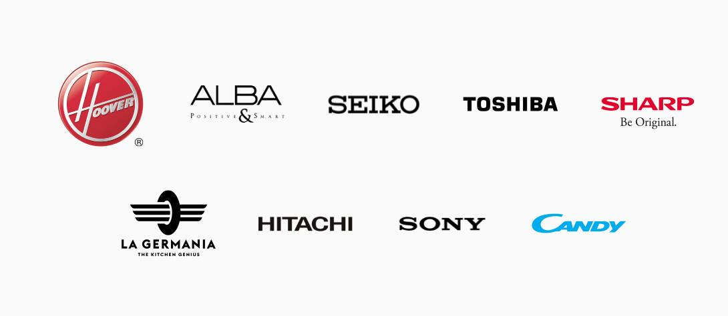
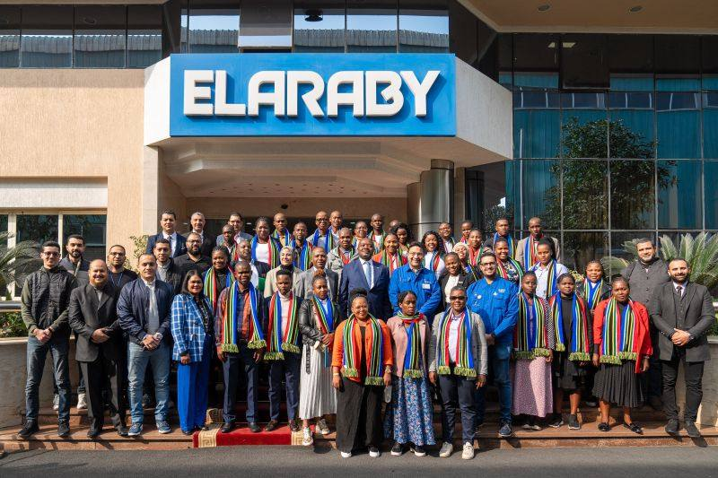

Licensing
Example
GROUP 4
Licensing
Kadry

Slide 22



Licensing
Example
GROUP 4
Licensing
Kadry

Slide 23
Licensing
  Advantages & Disadvantages
ADVANTAGES | DISADVANTAGES
✅ Licensing stretches product life cycles: Old models reused ✅ Zero production costs: Royalties fund R&D ✅ Bypass trade barriers: No tariffs on locally made goods. | ❌ Tech leakage: Licensees can become competitors ❌ Brand dilution: Over-licensing harms reputation ❌ Limited control: Licensors lose grip on quality and pricing
GROUP 4
Licensing
Kadry

Slide 24
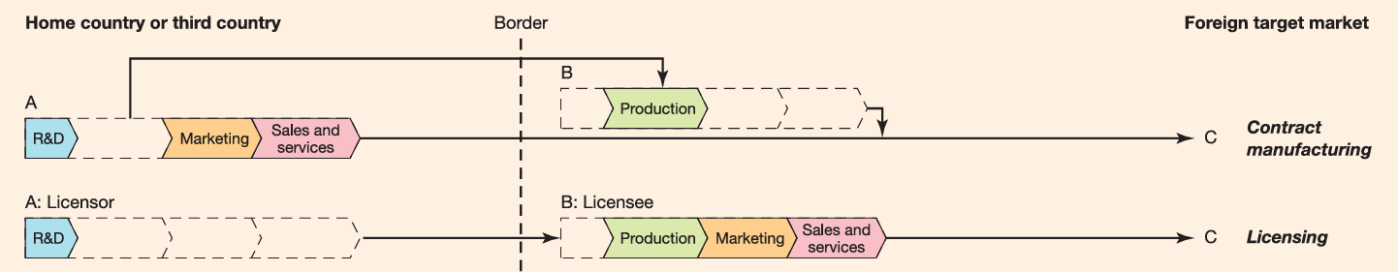
Recap
GROUP 4
Kadry

Slide 25
Franchising
"A business model where a brand licenses its operations to independent operators for a fee“
Franchise – The right to use a specific business name & sell goods/services under that name
Franchisor – The company that grants the license to use its trade name, trademark & business system
Franchisee – The individual or entity that purchases & operates the franchise
Franchising – A cooperative relationship between the franchisor & the franchisee to operate under a shared brand
GROUP 4
Geetanjali

Slide 26





Franchising Agreement
Franchisee pays an initial fee & ongoing royalties based on sales
Franchisee must follow the franchisor’s operational guidelines & quality standards
Franchisor provides support in areas like training, branding & sometimes setting up facilities
Agreements typically include territorial rights, duration, renewal terms & conditions for termination
Franchisor retains ownership of trademarks, business systems & intellectual property
GROUP 4
Franchising
Geetanjali

Slide 27
Types of Franchising
Direct Franchising
Home country
Host country
Franchisee
Franchisor
Franchisee
Indirect Franchising
Franchisee
Home country
Host country
Master franchisee (sub-franchisor)
Franchisor
Franchisee
Franchisee
Franchisee
GROUP 4
Franchising
Geetanjali

Slide 28

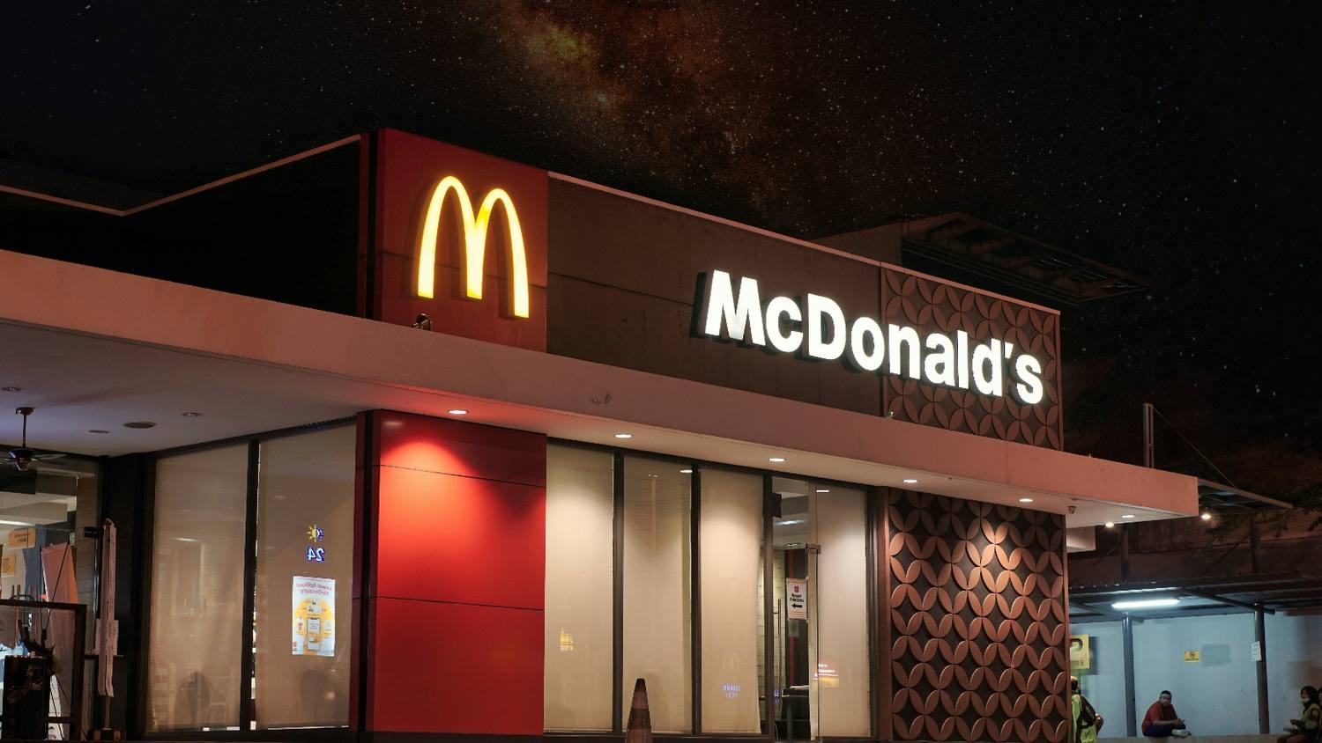
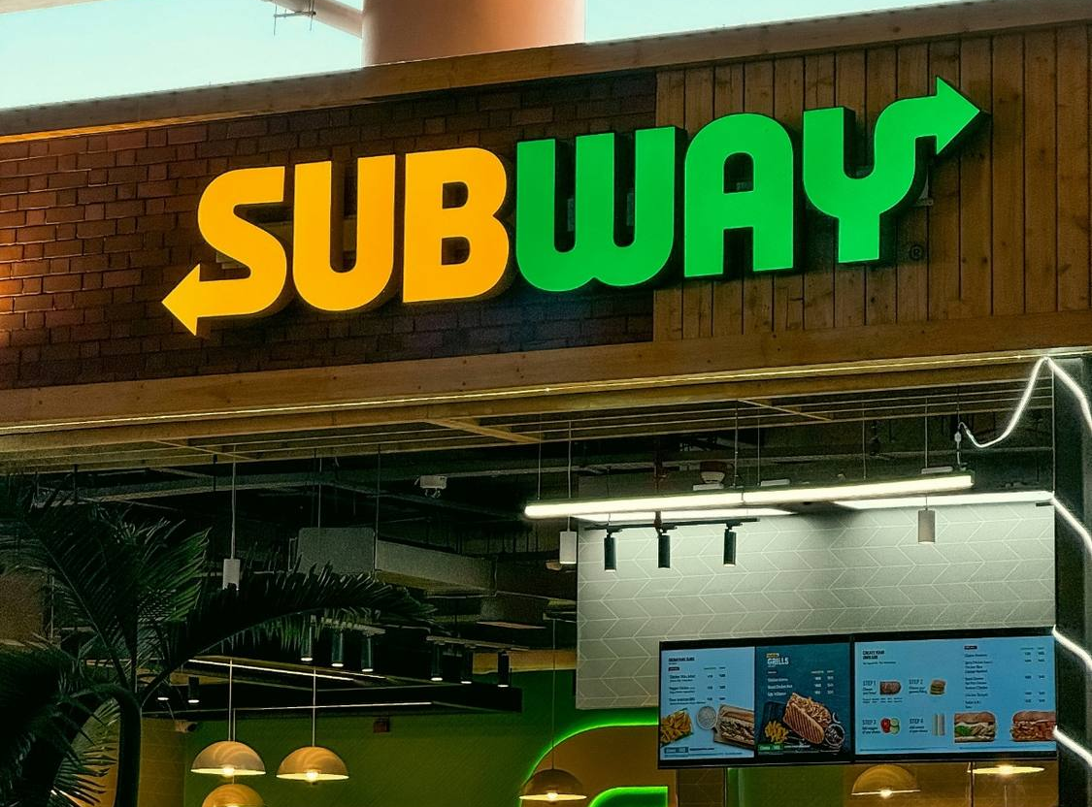
Franchising Examples
  MCDONALD’S
  Fast Food Restaurant
  38,000 franchises in 100+ countries
  Founded in 1955
  Franchising started in 1955
  SUBWAY
  Fast Food Restaurant
  37,000 franchises in 100+ countries
  Founded in 1965
  Franchising started in 1974
GROUP 4
Franchising
Geetanjali

Slide 29
Advantages & Disadvantages
ADVANTAGES
✅Low financial risk Investment & operational costs borne by the franchisee ✅ More control than licensing Franchisor can enforce brand standards & operational procedures ✅ Rapid expansion Multiple markets can be entered simultaneously ✅ Local Market Knowledge Helps adapt offerings to local consumer preferences & culture
DISADVANTAGES
❌ Limited market opportunities & profits Earnings depend on franchisee & local market conditions ❌ Possibility of creating future competitors Trained franchisees may later start competing businesses ❌ Reduced flexibility & operational complexity Standardization may limit innovation & slow adaptation
GROUP 4
Franchising
Geetanjali

Slide 30









Balancing Standardization & Flexibility
Consistent brand identity (logos)
Localized marketing campaigns
Unified customer experience across locations
Community engagement & sponsorships
Operational best practices
Regional product/service adaptations
Centralized training & onboarding
Local Language/cultural relevance
Quality control & compliance
STANDARDIZATION
FLEXIBILITY
Franchise success lies in the balance - protecting the brand while empowering local innovation
GROUP 4
Franchising
Geetanjali

Slide 31








Licensing vs. Franchising
 |  | Licensing | Franchising
 | Scope | Right to use intellectual property, trademark, tech | Right to use brand, system & full business model
 | Control | Minimal control by licensor | Significant control by franchisor
 | Support Provided | Little to no support | Extensive support (training, marketing, systems)
 | Business Format | No standardized business operation | Standardized operations & branding enforced
 | Regulations | Fewer legal formalities | Heavily regulated (franchise laws)
 | Examples | Disney licensing characters to toy companies | McDonald’s
GROUP 4
Licensing vs. Franchising
Geetanjali

Slide 32
Joint Venture
"A business arrangement where two or more parties pool resources to accomplish specific objectives"
GROUP 4
Jenny

Slide 33
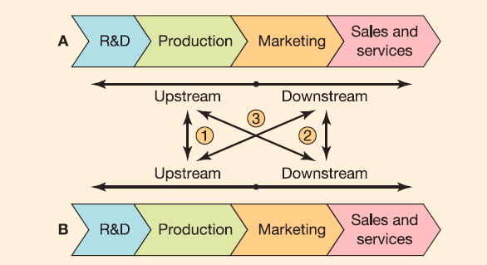


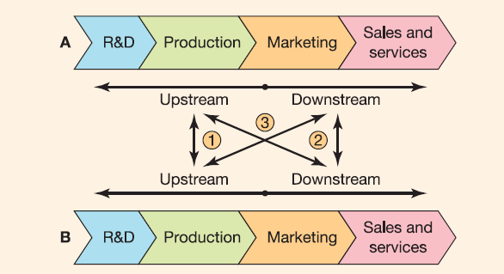

Joint Venture
Equity-based (new entity Joint Venture)
Entering new markets
Leverage local knowledge and distribution networks
Parent Firm A
Parent Firm B
Reducing Costs
Share production, R&D, or operational costs
Joint Venture C
No. | Coalition Type | Description | Real-world Example
 | Y coalition | Upstream - A and B collaborate on R&D and production | Pfizer & BioNTech
 | Y coalition | Downstream - A and B collaborate on marketing, distribution, sales and/or service
 | X coalition | A and B have different but complementary competences at each end of value chain | Apple & Foxconn
Technology & Innovation
Contract-based (strategic alliance
=non-equity joint
venture)
Collaborate on development and faster diffusion of technology
A
Contracts
B
GROUP 4
Joint Venture
Jenny

Slide 34
WOS Modes
(Wholly Owned Subsidiary)
"Establishing and owning the foreign operation to maintain full control over strategy, resources, and outcomes."
GROUP 4
Jenny

Slide 35




WOS Modes
Mode 1: Domestic-based sales representatives/OEM/Manufacturer‘s own sales force
R & D
Production
Marketing
Sales and Services
C
Direct
Mode 2: Resident sales representatives/sales subsidiary/sales branch
R & D
Production
Marketing
Sales and Services
C
Home Country
Border
Foreign Target Market
C-Customer
GROUP 4
WOS Modes
Jenny
Notes:
3M (USA) uses its U.S.-based export sales teams to manage international clients for niche industrial products without establishing physical presence abroad in all markets.
Bosch (Germany) operates dedicated sales subsidiaries like Bosch UK or Bosch India to serve local markets with tailored after-sales support.

Slide 36




WOS Modes
Mode 3: Sales and Production Subsidiary
R & D
Marketing
Production
Sales and Services
C
Mode 4: Region Center
R & D
Production
Marketing
Sales and Services
C
Mode 5: Full fledged insider
R & D
Production
Marketing
Sales and Services
C
Mode 6: Transnational Organization
by acquisition or greenfield investment
R & D
Production
Marketing
Sales and Services
R & D
Production
Marketing
Sales and Services
C
Home Country
Border
Foreign Target Market
C-Customer
GROUP 4
WOS Modes
Jenny
Notes:
Nestlé has a local production and sales subsidiary in India (Nestlé India Ltd), manufacturing products like Maggi noodles and selling them across the country.
Unilever (Netherlands/UK) operates regional centres like Unilever Southeast Asia (based in Singapore) to coordinate regional marketing strategies and product adaptation across ASEAN.
Toyota in the U.S. — Toyota Motor Manufacturing Kentucky (TMMK) conducts R&D, full-scale production, local marketing, and after-sales, making it a true “insider” in the U.S. market.
Examples of Acquisition in Transnational Strategy:
Tata Motors’ acquisition of Jaguar Land Rover (UK)
Tata, an Indian firm, integrated British luxury auto expertise into its global strategy.
Combines R&D from the UK with cost efficiency from India — classic transnational synergy.

Slide 37


Zara's Global Entry Playbook
GROUP 4
Jenny
Images source: Google

Slide 38
Routes to foreign Market Literature Review
Conducted Based on 5 step process followed in:
Schmitz/Urbano/Dandolini/de Souza/Guerrero, 2017: Innovation and entrepreneurship in the academic setting: a systematic literature review, in: International Entrepreneurship and Management Journal 13, 369-395.
GROUP 4
Khaled

Slide 39
Step 1 – Search Keywords
Goal: Identification of keywords related to “Routes to foreign Market”
Sources used for identification: Pre-reading materials
Primary keywords chosen:
"entry mode", "entry strategy", "global strategy", "routes to market", "international trade", "international business", "global market", "foreign entry", "foreign market", "international market", "international joint venture", "joint venture", "franchise", "foreign license", "license", "foreign direct investment", "outsource", "acquisition", "market selection", "internationalization", "relocate corporate", "Greenfield", "multinational".
GROUP 4
Literature Review
Khaled

Slide 40
Step 2 – Articles Search
Goal: Search relevant articles about “Routes to foreign Market” in the academic setting
Chosen Database: Web of Science (free source)
2.1 Boolean Search String:
(TS=("entry mode*") OR TS=(“entry strateg*”) OR TS=("global strateg*") OR TS=("routes to market") OR TS=("international *trade") OR TS=("international business*") OR TS=("global market*") OR TS=("foreign entry") OR TS=("foreign market*") OR TS=("international market*") OR TS=("international joint venture*") OR TS=("joint venture*") OR TS=("franchis*") OR TS=("foreign licens*") OR TS=("licens*") OR TS=("foreign direct investment") OR TS=("outsourc*") OR TS=("acquisition*") OR TS=("market selection") OR TS=("internationalization") OR TS=("relocat* corporate") OR TS=(“Greenfield”) OR TS=("multination*"))
Total initial output from Web of Science: 3738 Articles
2.2 WOS Filters Used:
Parameter | Selection
Selection | TS topic based (title, keyword, abstract)
Language | English
Publication Date | 2014-2025
Document Type | Article
Web of Science Categories | Economics, Management, Business, Business finance
Publication title sources | Journal of International Business Studies, International Business Review, Journal of World Business, Strategic Management Journal, Journal of International Marketing, Long Range Planning, journal of business research, Journal of marketing channels
GROUP 4
Literature Review
Khaled

Slide 41
Step 2 – Articles Search
Goal: Search relevant articles about “Routes to foreign Market” in the academic setting
Chosen Database: Web of Science (free source)
2.3 Excel Filters Used:
Parameter | Selection
Times Cited, All Databases | Greater than 50
Since 2013 Usage Count | Greater than 150
Final output after filteration: 396 Articles
GROUP 4
Literature Review
Khaled

Slide 42
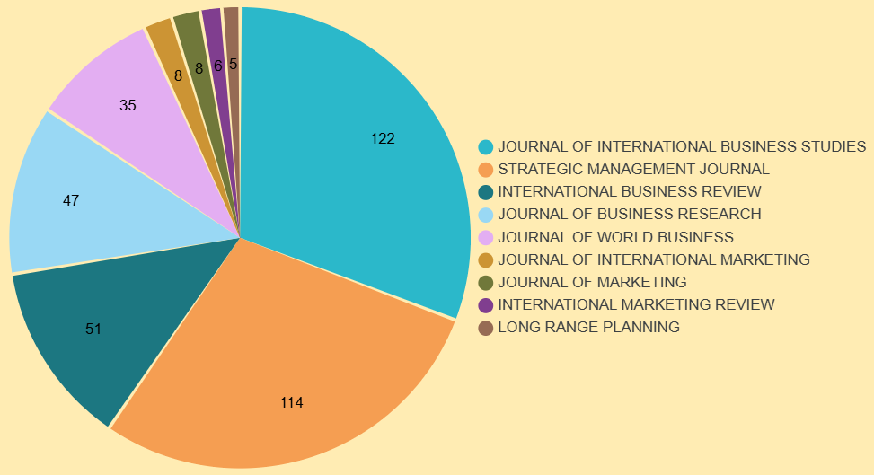
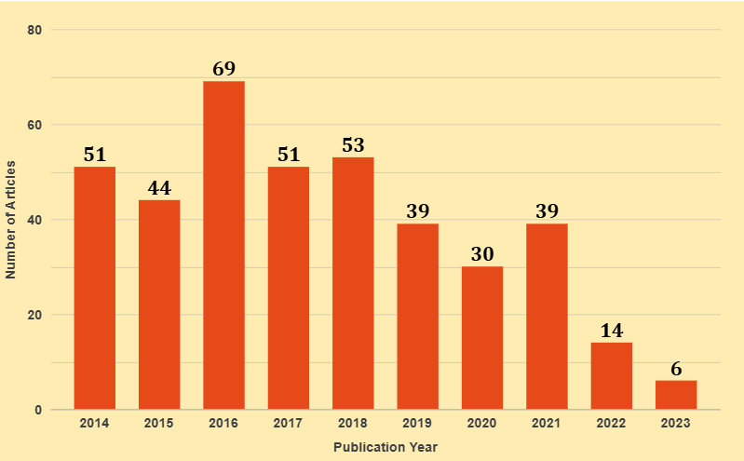
Step 3 – Bibliometric Analysis
Goal: Analyze patterns and trends from the 396 Articles using columns like publication year, journal, author keywords, citation count, etc.
Top Journals by Publication Count
Publication Trend Over Time
GROUP 4
Literature Review
Khaled

Slide 43
Step 4 – Article Selection for Content Analysis
Goal: Selection of 30 articles best fitting the objective of the study.
Check for keywords for relevance to the topic by understanding the content of the article (via Abstract reading)
Top 30 articles chosen for content analysis.
Relevance Scores 1-10 given to 396 articles.
GROUP 4
Literature Review
Khaled

Slide 44
Step 5 – Content Analysis-Terms/Frameworks
Goal: Identification of terms, definitions, theoretical frameworks, and research gaps & trends.
Terms | Frequency
Internationalization | 60
Entry mode | 23
Market entry | 15
Foreign market | 11
Acquisition | 9
Foreign direct investment | 4
Embeddedness | 3
Non-traditional entry | 2
GROUP 4
Literature Review
Khaled

Slide 45
Step 5 – Content Analysis-Terms/Frameworks
Goal: Identification of terms, definitions, theoretical frameworks, and research gaps & trends.
Theoretical Framework | Frequency (Out of 30) | Summary
Uppsala Model of Internationalization | 6 | Firms internationalize gradually through learning and experience; commitment increases with knowledge.
Transaction Cost Economics (TCE) | 5 | Firms choose entry modes that minimize transaction costs in uncertain or opportunistic environments.
Eclectic Paradigm (OLI Model) | 5 | Entry mode depends on Ownership, Location, and Internalization advantages.
Resource-Based View (RBV) | 4 | Entry is based on leveraging unique, valuable internal resources and capabilities.
Institutional Theory | 3 | Entry strategy is shaped by host country's formal/informal institutional environments.
Dynamic Capabilities Framework | 2 | Firms adapt and reconfigure resources to respond to dynamic international environments.
Network Theory | 2 | Firms enter new markets through existing relationships and networks; especially relevant for SMEs.
GROUP 4
Literature Review
Khaled

Slide 46
Step 5 – Content Analysis-Research Gaps/Trends
Underexplored Non-Traditional Entry Modes
Limited Integration of Digitalization in Entry Mode Theories
Weak Coverage of Emerging Markets as Entry Targets
Lack of Multi-Level or Mixed-Method Approaches
Limited Attention to SME and Startup Internationalization
Few Comparative Studies Across Industry Sectors
GROUP 4
Literature Review
Khaled

Slide 47
Charting new courses to enter foreign markets: Conceptualization, theoretical framework, and research directions on non-traditional entry modes.
Authors: Keith D. Brouthers, Liang Chen, Sali Li, and Noman Shaheer.
Source: Journal of International Business Studies (Vol. 53, 2022, pp. 2088–2115) – Published April 22, 2022
GROUP 4
Ravi

Slide 48
New Paths to Foreign Markets
Traditional
Digital Evolution
Non-Traditional
More Exploration
Capital Access
Innovation Outposts
Low local embeddedness
High local embeddedness
Virtual Presence
Managed Ecosystems
More Exploitation
GROUP 4
Non-Traditional Modes
Ravi

Slide 49


Capital Access-“Reverse“ Foreign Direct Investment
“Entering a foreign market financially rather than physically”
How It’s Done: List shares on a foreign stock exchange, issue bonds or get loans abroad, or attract overseas venture capital and private equity
Why It Matters:
Provides access to large pools of capital and often global credibility
It’s a low-control, low-cost entry mode.
No new foreign subsidiary needed
GROUP 4
Non-Traditional Modes
Ravi

Slide 50
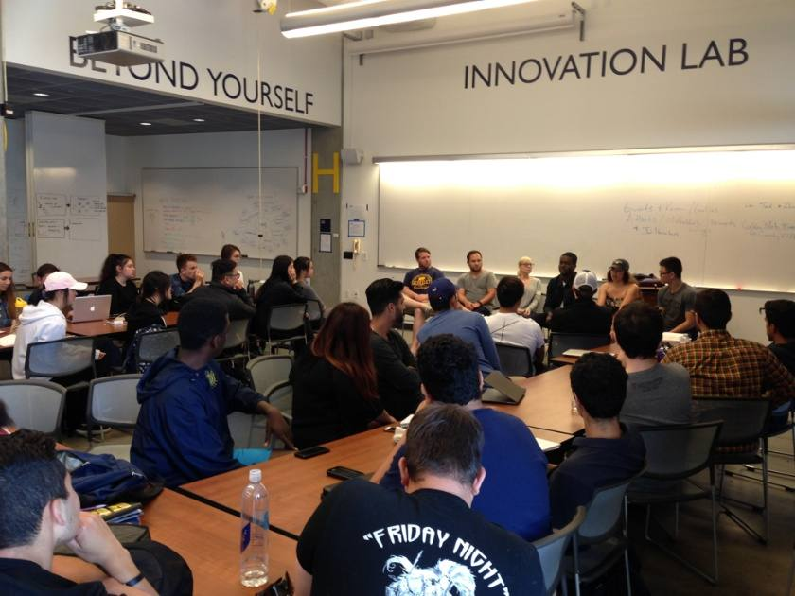

Innovation Outposts – Global Idea Scouts
“Setting up a small “listening post” or R&D team in a foreign innovation hotspot to scout new ideas, cutting-edge technologies, or practices”
How It Works: The outpost team continuously builds relationships with local startups, universities, and experts – becoming “insiders” in the local scene
Contrast to Traditional:
Instead of entering to generate sales, this mode enters to import local knowledge
No need for distribution channels or immediate revenue
GROUP 4
Non-Traditional Modes
Ravi

Slide 51


Virtual Presence – Going Borderless Online
“No physical entry, no local offices – the firm appears “present” to foreign customers purely via the internet”
How It Works: Acquire customers abroad through platforms. Deliver value electronically or ship products across borders without setting up local stores
Contrast to Traditional:
No need for local distributors, agents, or franchise partners
No spending on foreign retail space or joint ventures
GROUP 4
Non-Traditional Modes
Ravi

Slide 52


Managed Ecosystems – Platform Plays Abroad
“Entering foreign markets via a multi-sided platform model”
How It Works: The firm bridges foreign demand and supply by extending its digital platform into the target country, enabling local users and service providers to transact.
Contrast to Traditional:
Unlike a franchise or JV, the local contributors are usually independent actors who choose to use the platform to attract customers.
Platform owns no physical assets.
GROUP 4
Non-Traditional Modes
Ravi

Slide 53
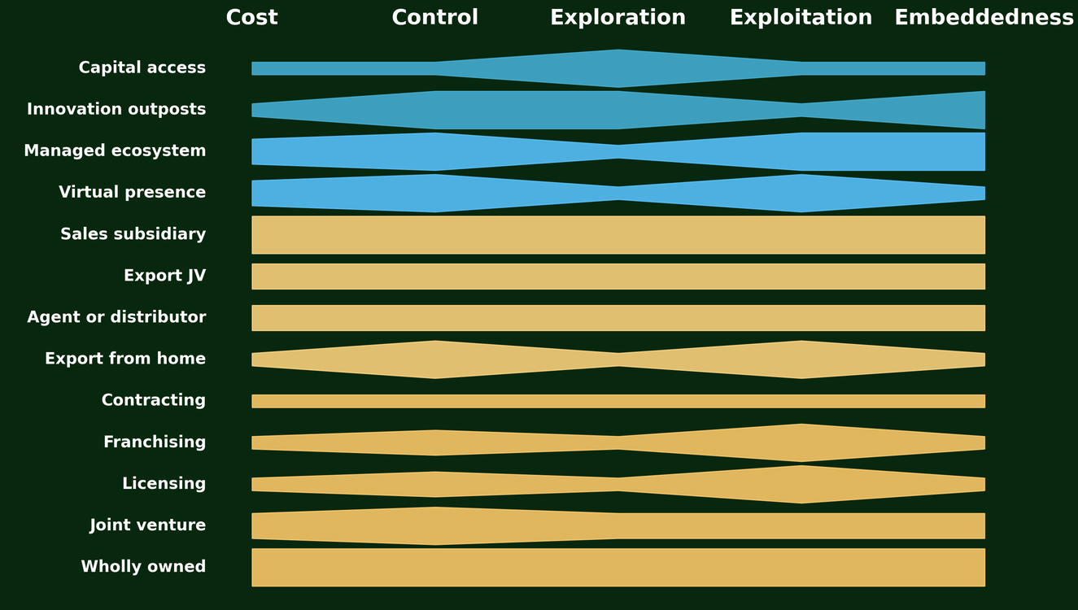
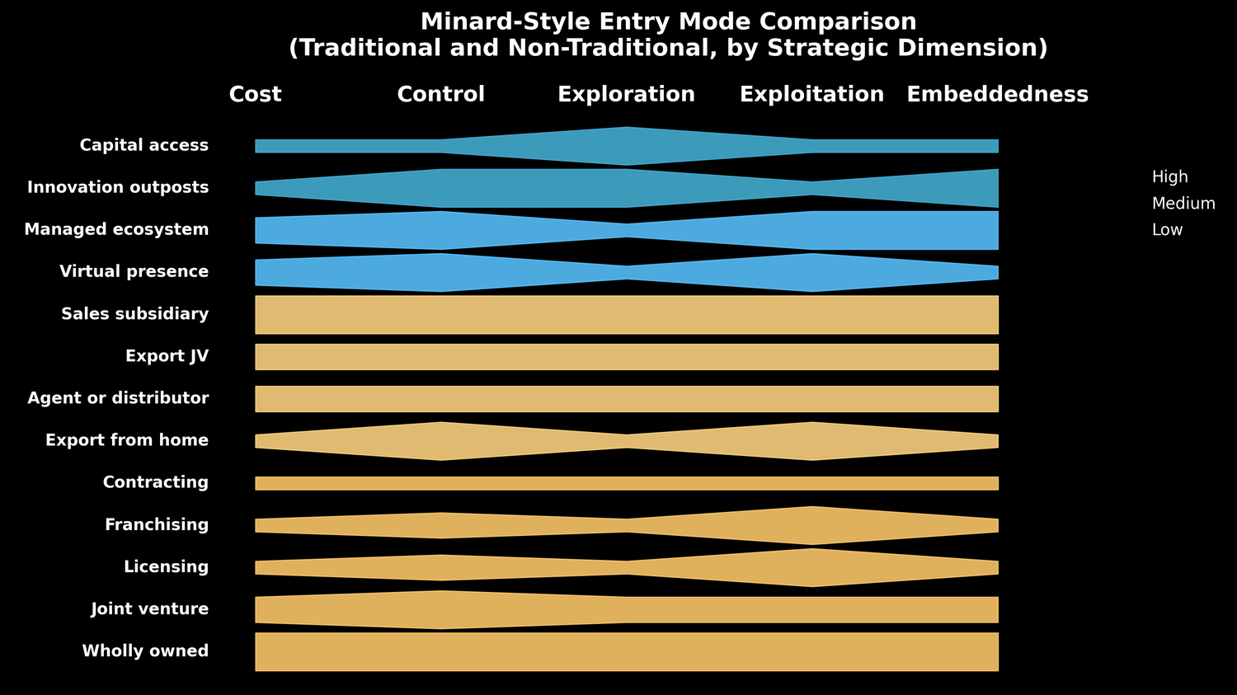
Summary: Routes to Foreign Market
High
Medium
Low
GROUP 4
Non-Traditional Modes
Ravi

Slide 54
References
Hollensen, S. (2014). Global marketing (6th ed.). Pearson Education Limited. ISBN 978-0-273-77316-0
Richter, N. F., Strandskov, J., Hauff, J. C., & Taras, V. (2022). International business strategy and cross-cultural management: An applied approach. Edward Elgar Publishing.
Brouthers, K. D., Chen, L., Li, S., & Shaheer, N. (2022). Charting new courses to enter foreign markets: Conceptualization, theoretical framework, and research directions on non-traditional entry modes. Journal of International Business Studies, 53(11), 2088–2115.
GROUP 4

Slide 55
Thank you.
APPLIED MARKET

